Slide 1
Rat In A Maze Problem Project
Ritvik Chawla (Registration Number: 209301056)
Section: E
Subject:Artificial Intelligence & Soft Computing Lab | CS 3131|

Slide 2
Agenda
1. Define any problem which must be solved using an AI agent, write down its formal definition(initial state, final state, transition model, path cost), and PEAS.[CO1, 2]
2. Identify any search technique(uninformed/informed) to solve the problem, you may compare various techniques as well. [CO 1,2]
3. Optimize the solution using any of the studied optimization techniques.

Slide 3
Definition of the problem
In this problem, a given maze of size N x N exists. The source and destination locations are top-left and bottom-right cells, respectively. Some cells are valid to move and some cells are blocked. If one rat starts moving from the start vertex to the destination vertex, we have to find that is there any way to complete the path, if it is possible then mark the correct path for the rat.
The maze is given using a binary matrix, where it is marked with 1, it is a valid path, otherwise 0 for a blocked cell.

Slide 4
Initial State, Final State
The initial state of the rat in a maze problem is at whatever location the rat is placed (usually (0,0)) in a square matrix m[ ][ ] of order n.
The final state of the problem is to reach the destination at (n-1, n-1). The task is to find a sorted array of strings denoting all the possible directions that the rat can take to reach the destination at (n-1, n-1).

Slide 5
Transition Model, Path Cost
The transition model consists of all the destination nodes the rat reaches through directions in order to reach its final destination. The directions in which the rat can move are ‘U'(up), ‘D'(down), ‘L’ (left), ‘R’ (right).
Path cost will turn out to be minimum when the shortest path to the destination will be taken. Since here, heuristic values aren’t taken, there is no definitive path cost.

Slide 6
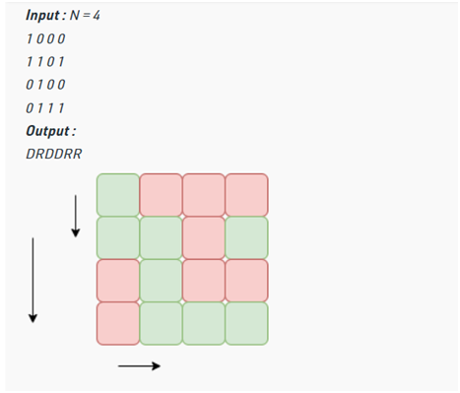
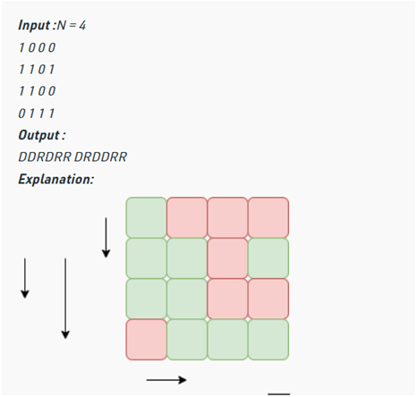

Slide 7
PEAS (Performance Measure, Environment, Actuators, Sensors)
Performance Measure: This will be regarded as the minimum number of moves in which the rat can reach the final destination in the matrix(maze) from the initial state.
Environment: The environment will be the N x N matrix(maze) where the rat is supposed to move in various directional steps to reach a certain destination.
Actuators: The actuators for this problem will be the keyboard direction arrows on a laptop or our fingers for a touch phone where we can give directions to the rat so it gets into motion.
Sensors: As you type, the processor in the keyboard analyzes the key matrix and determines what characters to send to the computer.

Slide 8
Search Technique Used
I have used the Brute Force Approach as a search technique, where we can use simple backtracking without using any extra space.
Here,
Backtracking Algorithm: Backtracking is an algorithmic-technique for solving problems recursively by trying to build a solution incrementally. Solving one piece at a time, and removing those solutions that fail to satisfy the constraints of the problem at any point of time (by time, here, is referred to the time elapsed till reaching any level of the search tree) is the process of backtracking.

Slide 9
Start from the initial index (i.e. (0,0)) and look for the valid moves through the adjacent cells in the order Down->Left->Right->Up (so as to get the sorted paths) in the grid.
If the move is possible, then move to that cell while storing the character corresponding to the move(D,L,R,U) and again start looking for the valid move until the last index (i.e. (n-1,n-1)) is reached.
Also, keep on marking the cells as visited and when we traversed all the paths possible from that cell, then unmark that cell for other different paths and remove the character from the path formed.
As the last index of the grid(bottom right) is reached, then store the traversed path.

Slide 10
Time and Space Complexity
O(3^(n^2))
O(3^(n^2))

Slide 11
Optimized Approach
O(3^(n^2))
O(1)

Slide 12
Thank you
Ritvik Chawla​
Registration Number: 209301056
Section E, Batch 1

